Slide 1
Cycloid Reducer
周奕彬

Slide 2
大綱
擺線減速機位移方程式
實例

Slide 3

位移方程式-epicycloid
K( a₄cosϕ₂ + a₃cosθ,
a₄sinϕ₂ + a₃sinθ )
O_{r}(a­₁, 0)
$\left|\overline{\text{KO}\text{r}}\right|$ = a₂

Slide 4

位移方程式 - epicycloid
$a_{1}=R$
$a_{2}=Rc+Rr$
$a_{3}=\left|\overline{K_{a}−O_{c}}\right|$
$a_{4}=E$

Slide 5
位移方程式
(a₄cos ϕ₂ + a₃cosθ − a­₁)² + (a₄sin ϕ₂ + a₃sinθ)² = a₂²
F sinθ + G cosθ = H

Slide 6
位移方程式
F = − 2a₃a₄sin(ϕ₂)
G = 2a₁a₃ − 2a₃a₄cos(ϕ₂)
H = a₁² + a₃² + a₄² − a₂² − 2a₁a₄cos(ϕ₂)

Slide 7
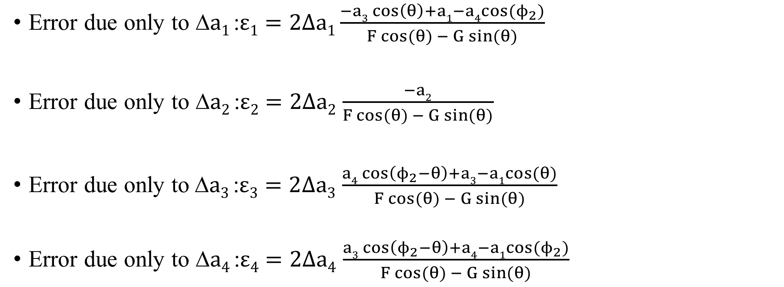
位移方程式-加入誤差項
Error due only to $\text{∆}a1$:$ε1=2∆a1\frac{−a3\cos\left(θ\right)+a1−a4cos(ϕ_{2})}{F cos⁡(θ) − G sin⁡(θ)}$
Error due only to ∆$a2$:$ε2=2∆a2$ $\frac{−a2}{F cos⁡(θ) − G sin⁡(θ)}$
Error due only to$\text{∆}a3$ :$ε3=2∆a3$ $\frac{a4\cos\left(ϕ_{2}−θ\right)+a3−a1cos(θ)}{F cos⁡(θ) − G sin⁡(θ)}$
Error due only to ∆$a4$ :$ε4=2∆a4$ $\frac{a3\cos\left(ϕ_{2}−θ\right)+a4−a1cos(ϕ_{2})}{F cos⁡(θ) − G sin⁡(θ)}$

Slide 8
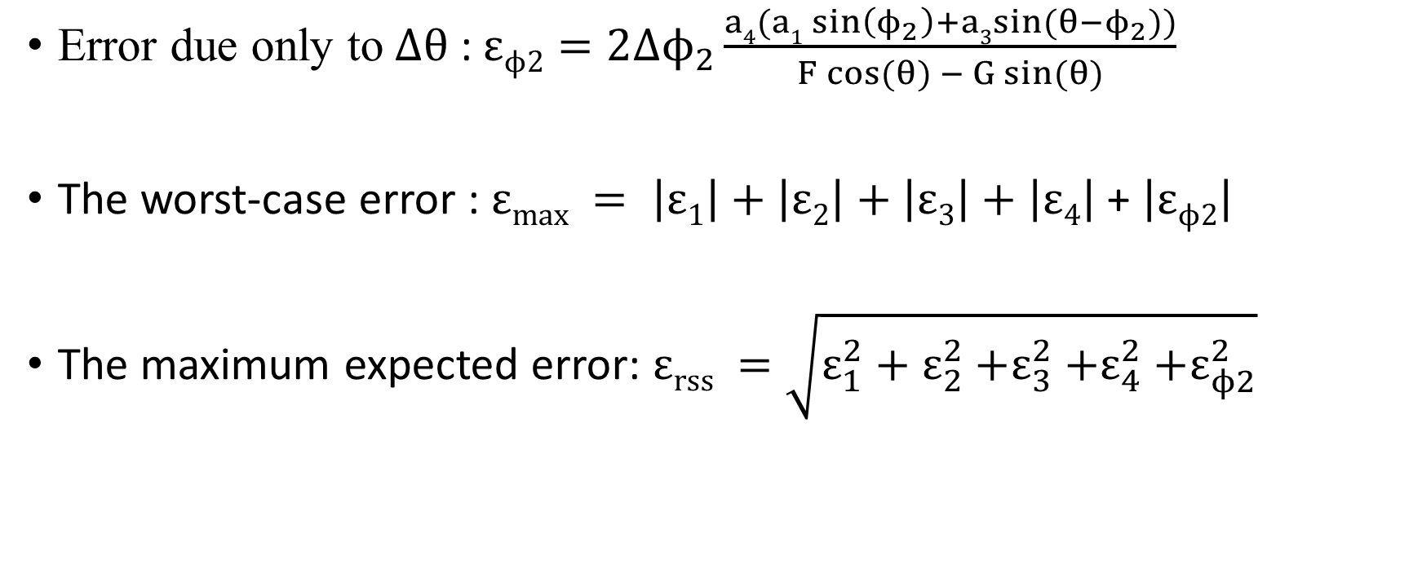
位移方程式-加入誤差項
Error due only to$∆θ$ : $εϕ2=2∆ϕ_{2}\frac{a4(a1\sin\left(ϕ_{2}\right)+a3sin⁡(θ−ϕ_{2}))}{F cos⁡(θ) − G sin⁡(θ)}$
The worst-case error :$εmax = \left|ε1\right|+\left|ε2\right|+\left|ε3\right|+\left|ε4\right|$ + $\left|εϕ2\right|$
The maximum expected error: $εrss =\sqrt{ε_{1}^{2}+ε_{2}^{2}{+ε}_{3}^{2}{+ε}_{4}^{2}{+ε}_{ϕ2}^{2}}$

Slide 9
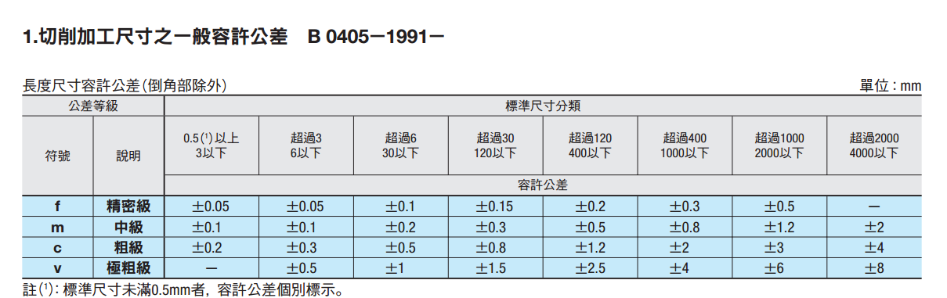
公差表

Slide 10
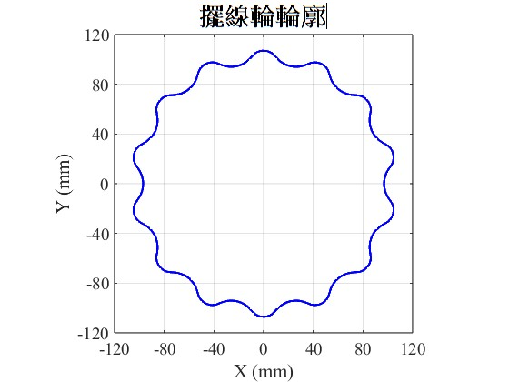
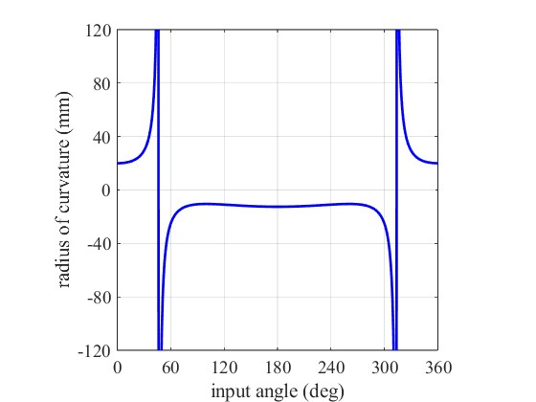
實例 - epicycloid N = 15, Rr = 18, R = 120, E =5

Slide 11
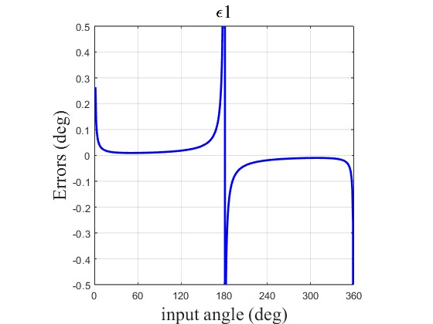
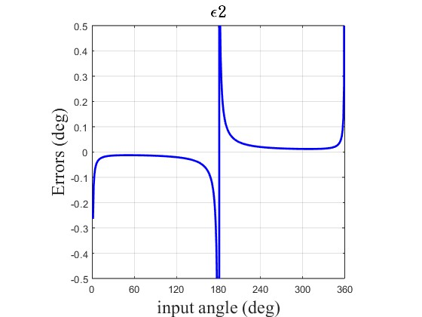
實例 - epicycloid

Slide 12

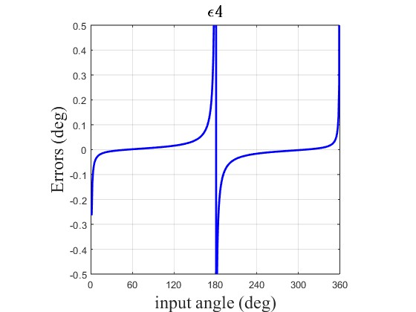
實例 - epicycloid

Slide 13
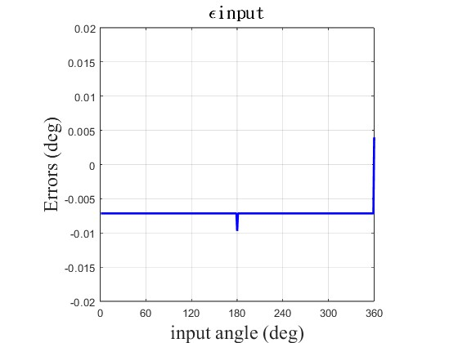
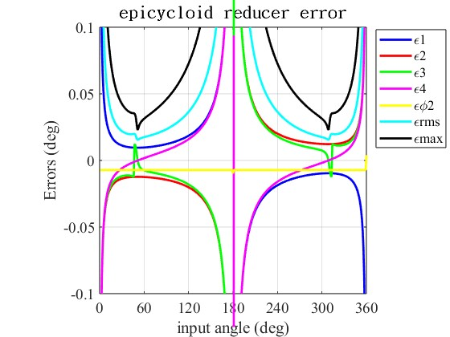
實例 - epicycloid

Slide 14

位移方程式 - hypocycloid
$b_{1}=\left|\overline{K_{b}−O_{1}}\right|$
$b_{2}=Rc+Rr$
$b_{3}=R$
$b_{4}=E$
${\text{ϕ}\text{2}}^{′}=$ ϕ₂ $−ζ$
$θ^{′}=θ−ζ$

Slide 15
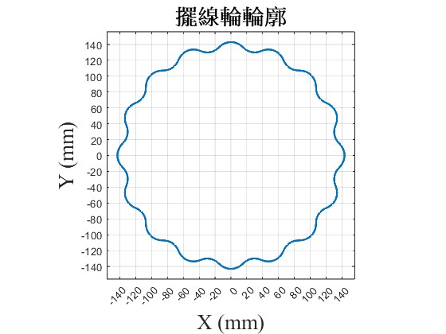
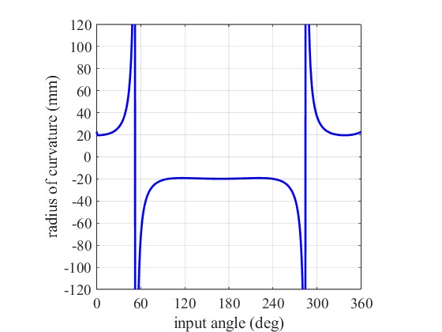
實例 - hypocycloid N = 15, Rr = 18, R = 120, E =5

Slide 16
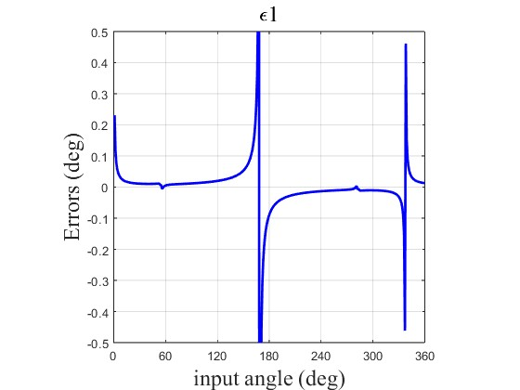
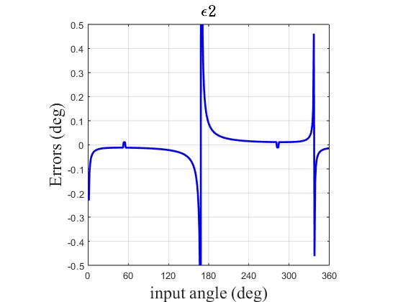
實例 - hypocycloid

Slide 17

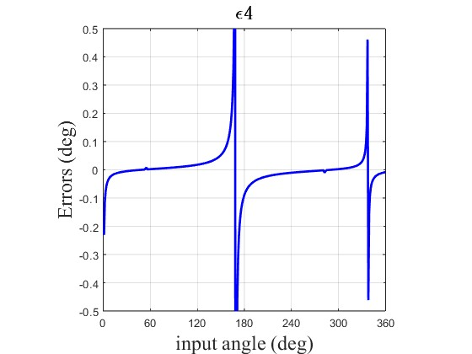
實例 - hypocycloid

Slide 18
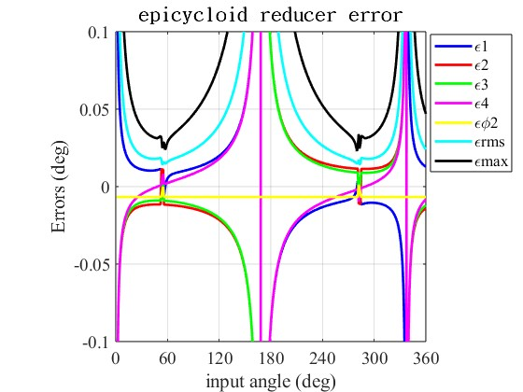
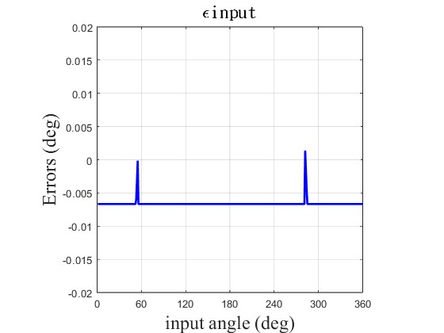
實例 - hypocycloid

